Slide 1
CSE 350 Data Communication
Chapter 4 :Digital Transmission

Slide 2
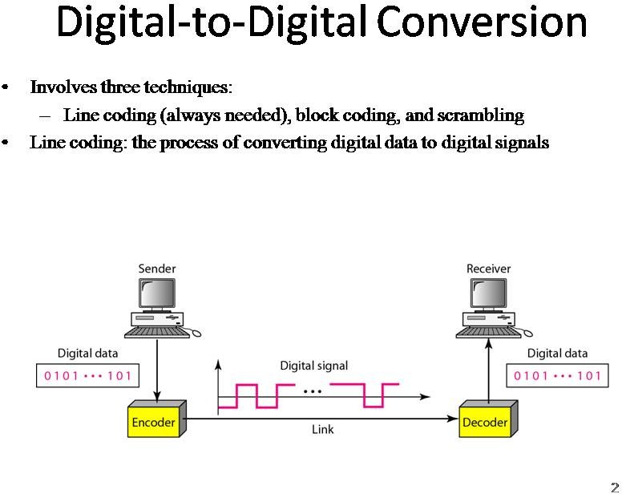

Slide 3
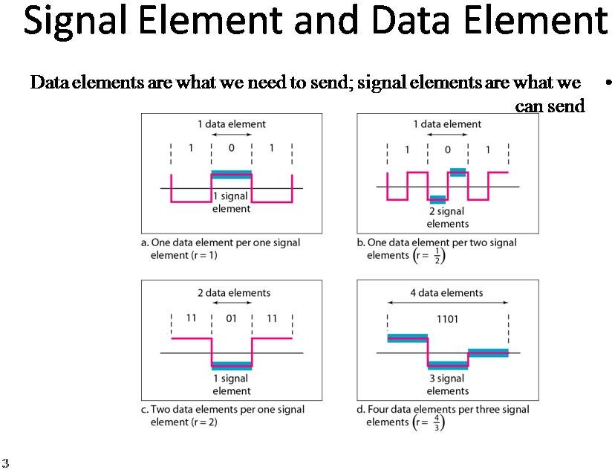

Slide 4
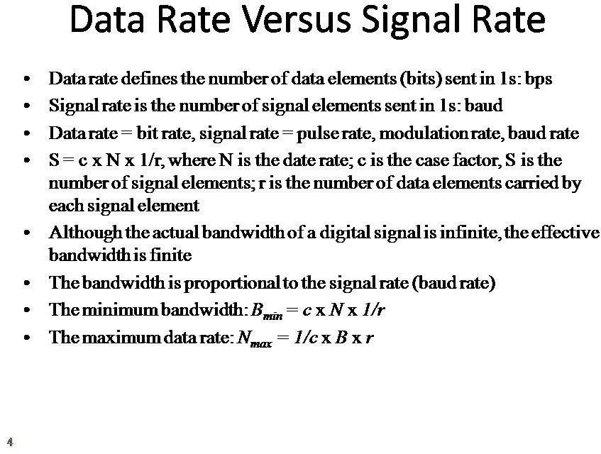

Slide 5
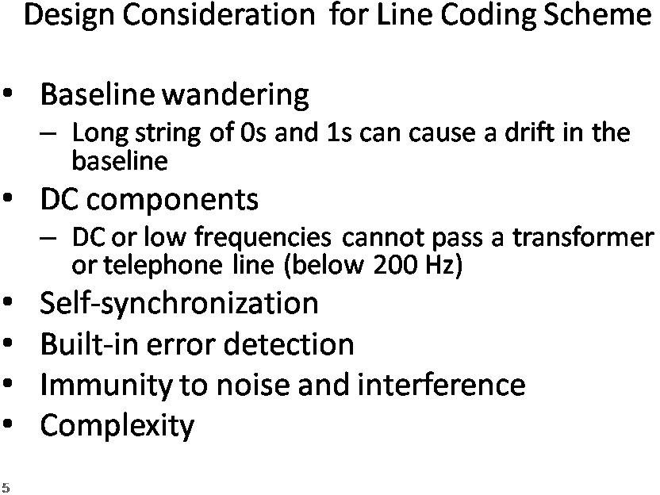

Slide 6
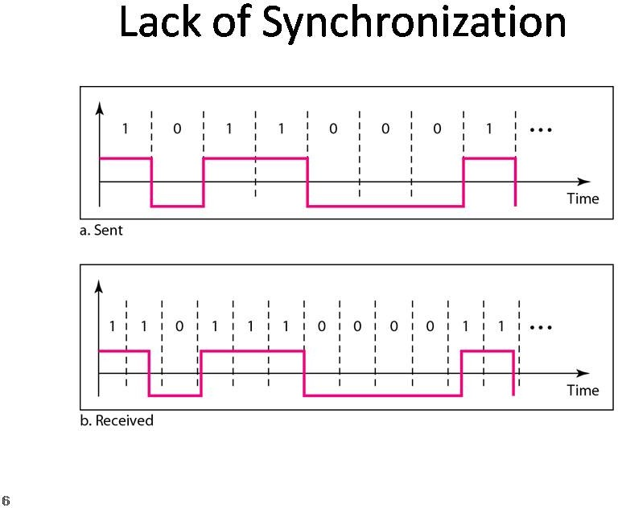

Slide 7
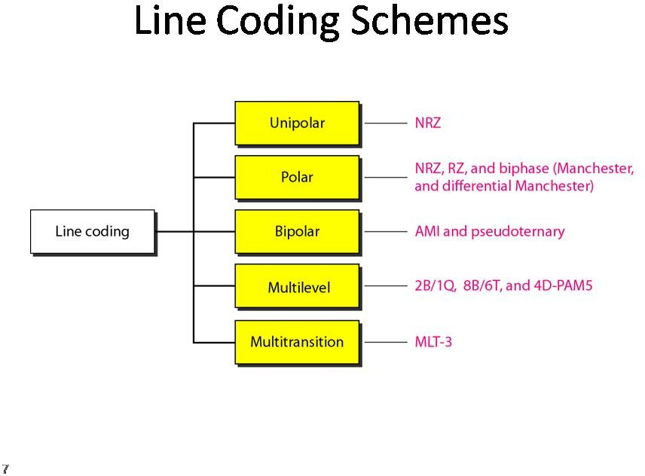

Slide 8
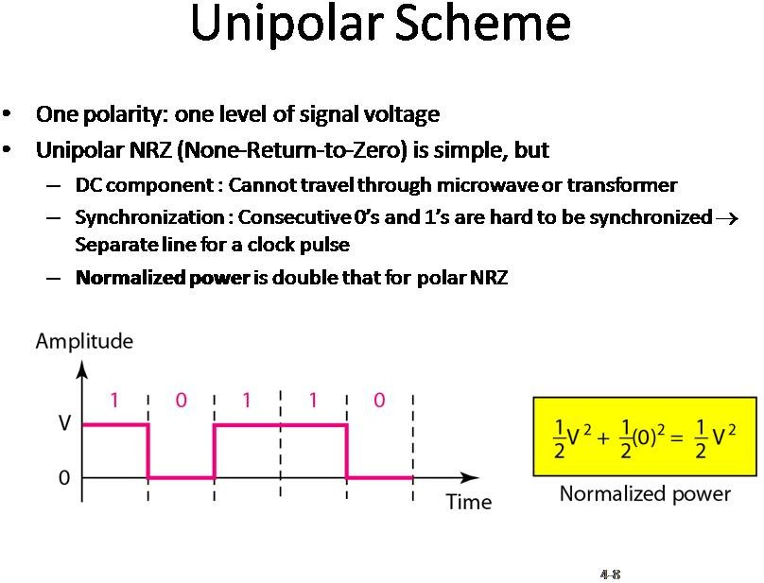

Slide 9
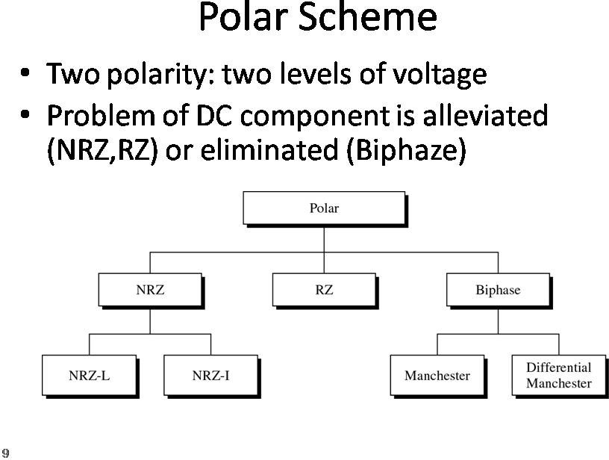

Slide 10
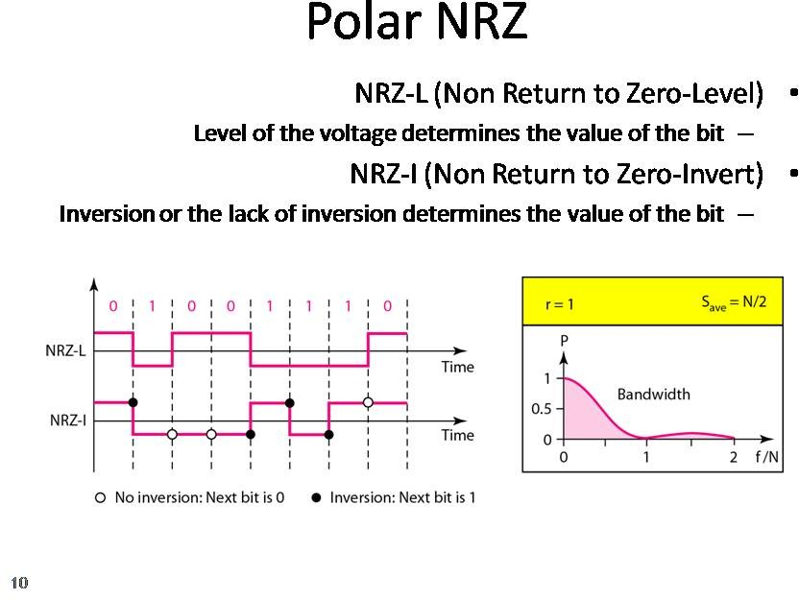

Slide 11
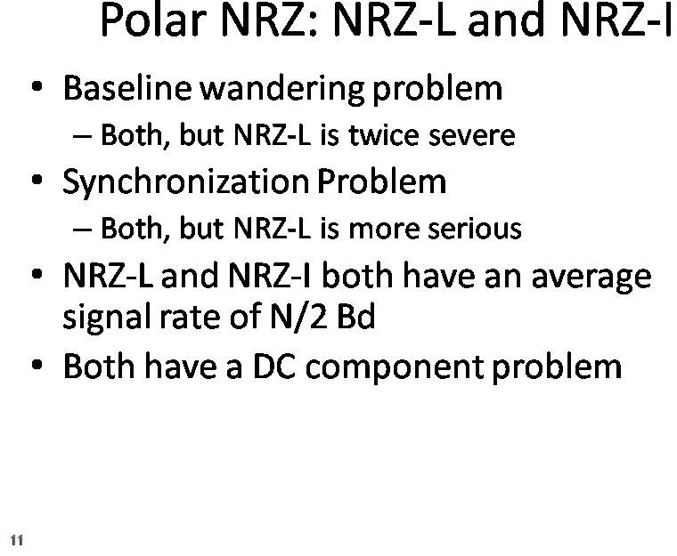

Slide 12
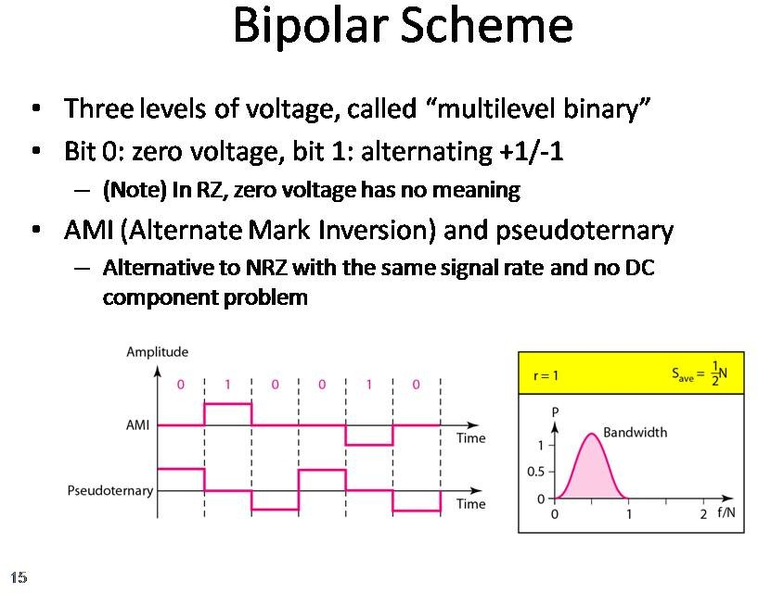

Slide 13
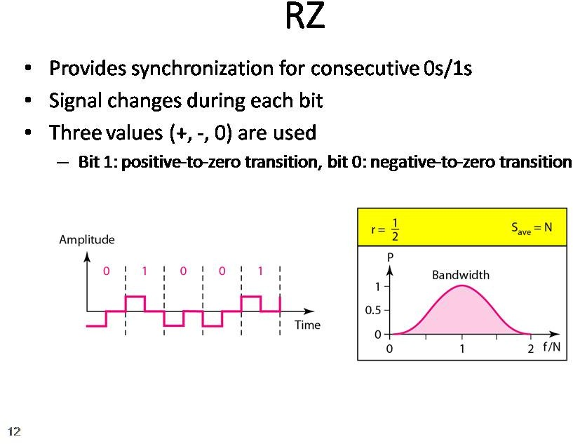

Slide 14
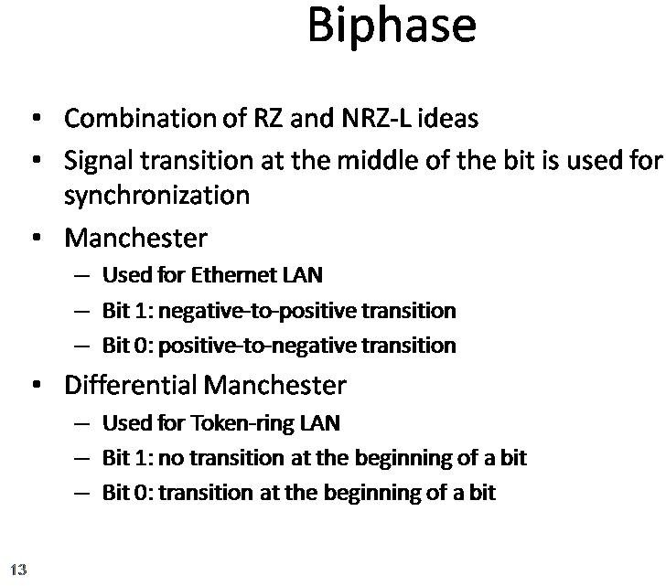

Slide 15
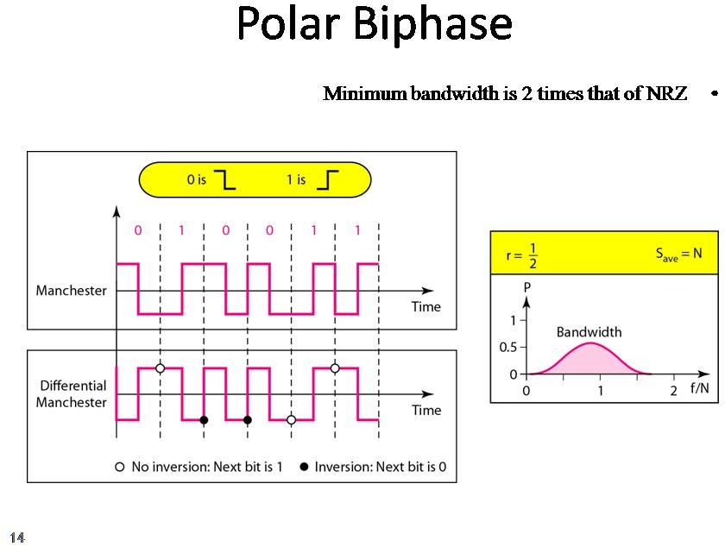

Slide 16
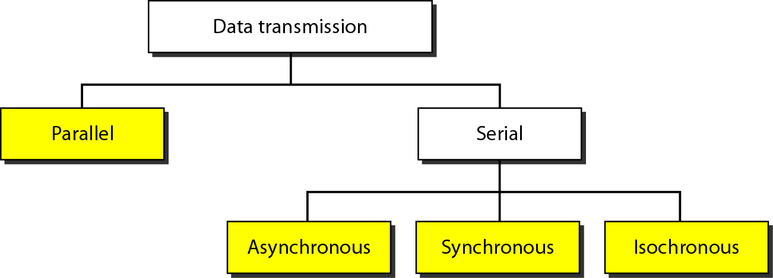
Transmission Modes

Slide 17
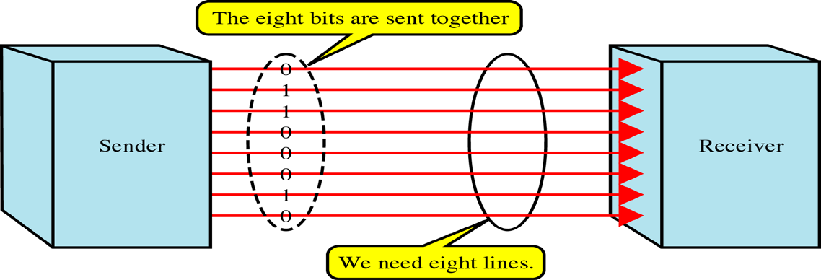
Parallel Transmission
Use n wires to send n bits at one time synchronously
Advantage: speed
Disadvantage: cost ⇒ Limited to short distances

Slide 18
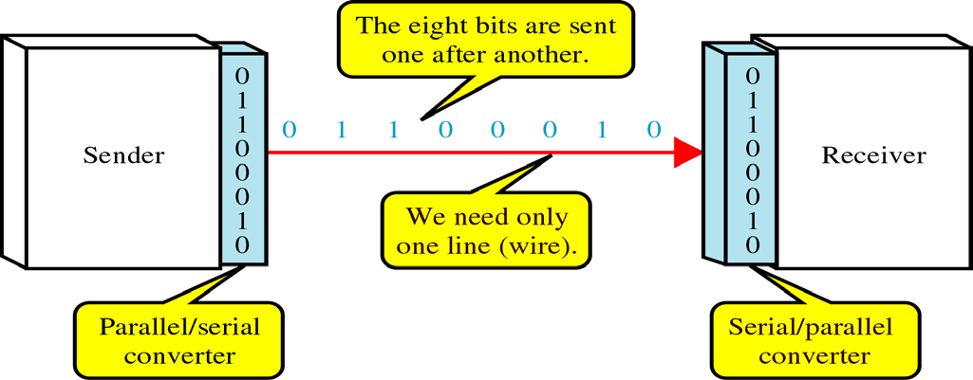
Serial Transmission
On communication channel
Advantage: reduced cost
Parallel/serial converter is required
Three ways: asynchronous, synchronous, or isochronous

Slide 19
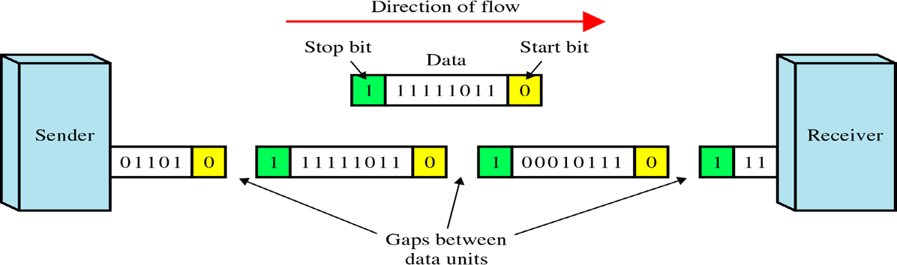
Asynchronous Transmission
Use start bit (0) and stop bits (1s)
A gap between two bytes: idle state or stop bits
It means asynchronous at byte level
Must still be synchronized at bit level
Good for low-speed communications (terminal)

Slide 20
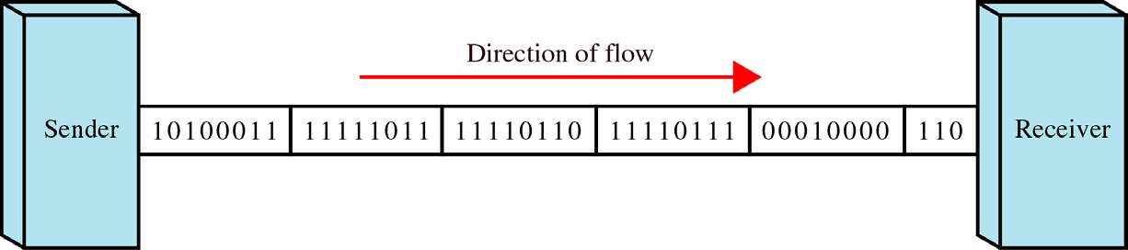
Synchronous Transmission
Bit stream is combined into “frames”
Special sequence of 1/0 between frames: No gap
Timing is important in midstream
Byte synchronization in the data link layer
Advantage: speed ⇒ high-speed transmission

Slide 21
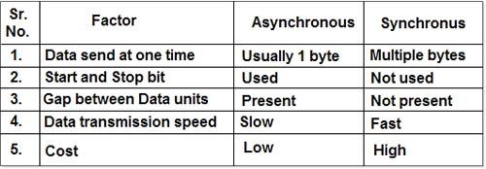
Asynchronous vs Synchronous

Slide 22
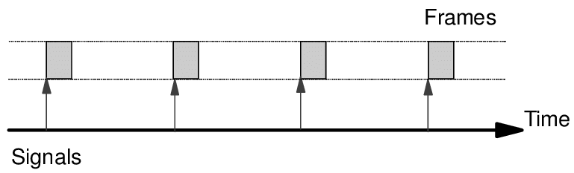
Isochronous Transmission
In real time audio & video, in which uneven delays between frames are not acceptable, synchronous transmission fails
Data arrives at a fixed rate
Ex: TV image

Slide 23
Thank You

